Slide 1
A Gentle Introduction to Bilateral Filtering and its Applications
“Fixing the Gaussian Blur”:
the Bilateral Filter
Sylvain Paris – MIT CSAIL

Slide 2


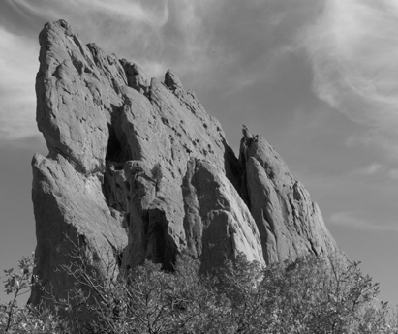
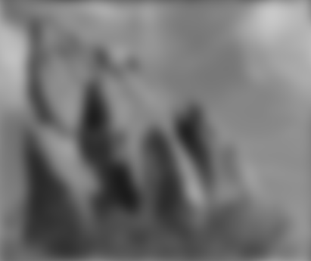


Blur Comes from
Averaging across Edges
*
input
output
*
*
Same Gaussian kernel everywhere.

Slide 3

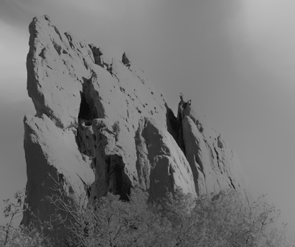


Bilateral Filter
No Averaging across Edges
[Aurich 95, Smith 97, Tomasi 98]
*
input
output
*
*
The kernel shape depends on the image content.

Slide 4
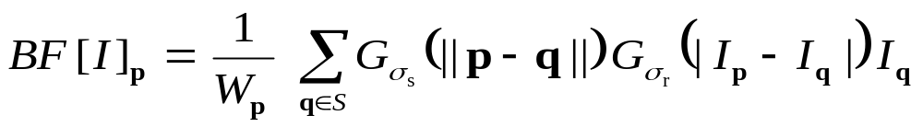
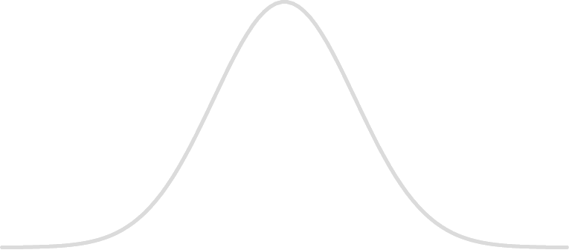
Bilateral Filter Definition: an Additional Edge Term
Same idea: weighted average of pixels.
new
not new
new
normalization
factor
space weight
range weight
I

Slide 5
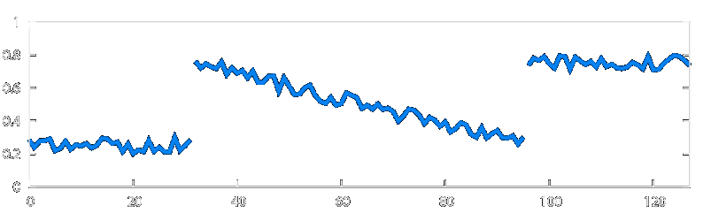
Illustration a 1D Image
1D image = line of pixels
Better visualized as a plot
pixel
intensity
pixel position

Slide 6
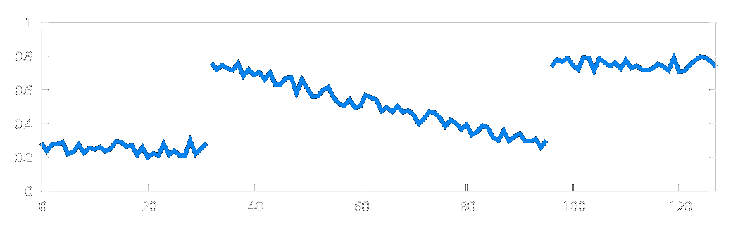
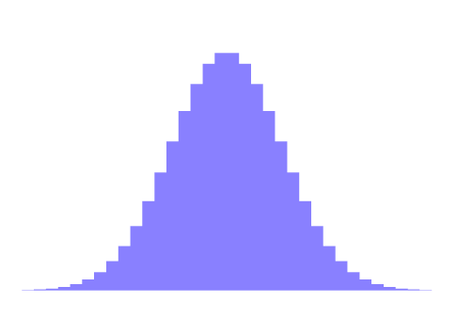
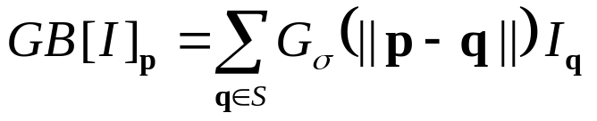

Gaussian Blur and Bilateral Filter
Gaussian blur
p
q
space
space
Bilateral filter
[Aurich 95, Smith 97, Tomasi 98]
p
range
q
space
range
normalization
space

Slide 7
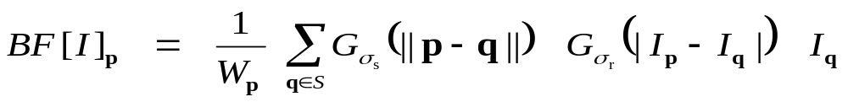
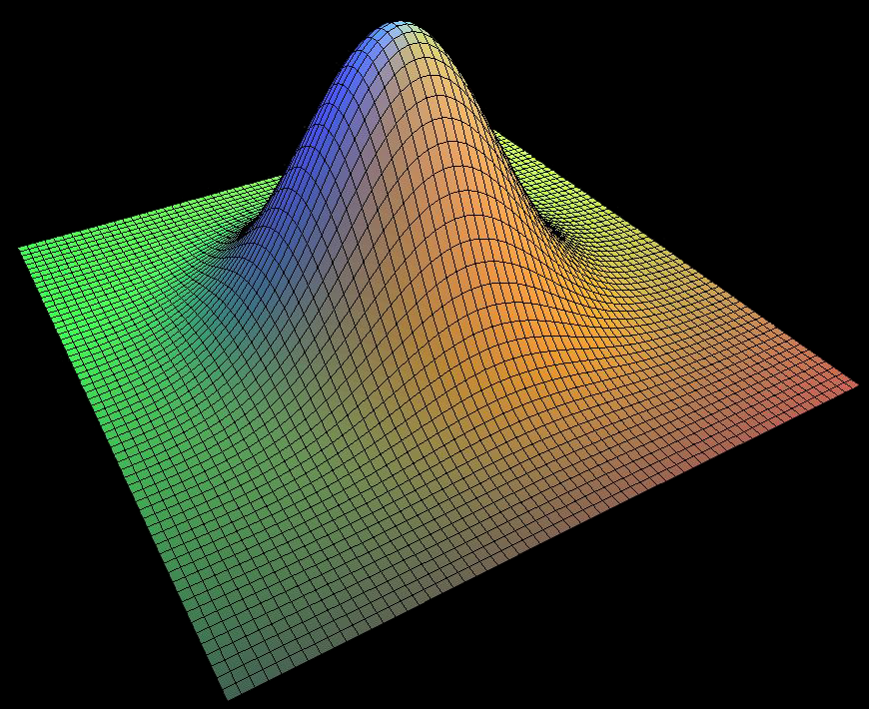
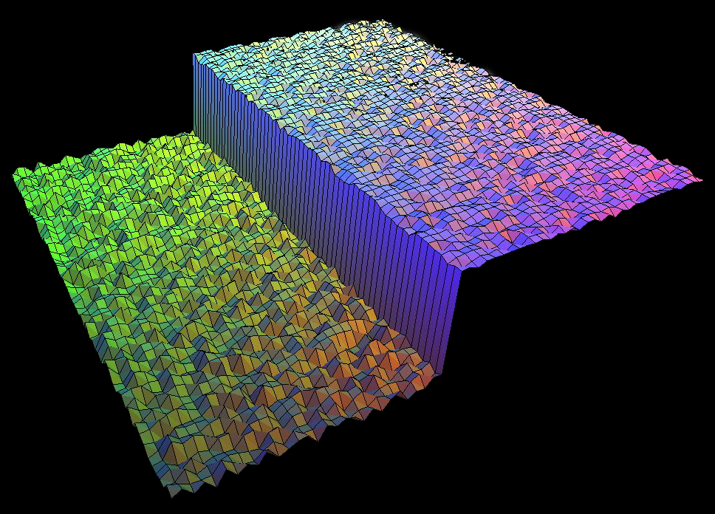
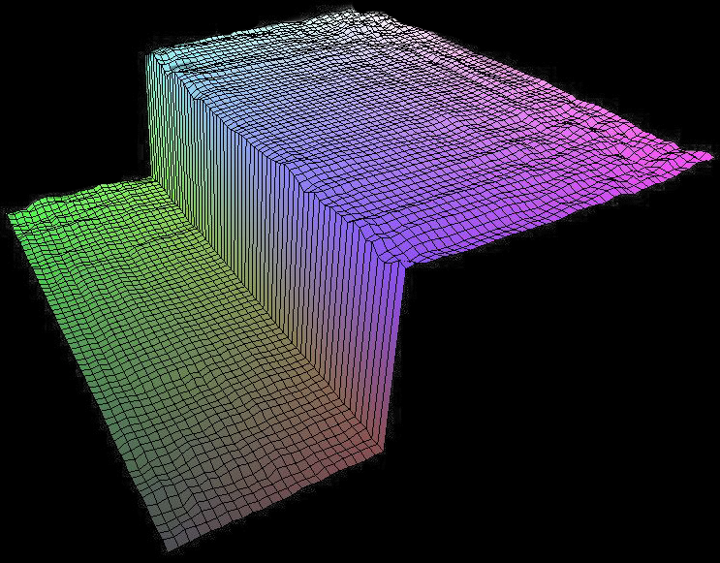
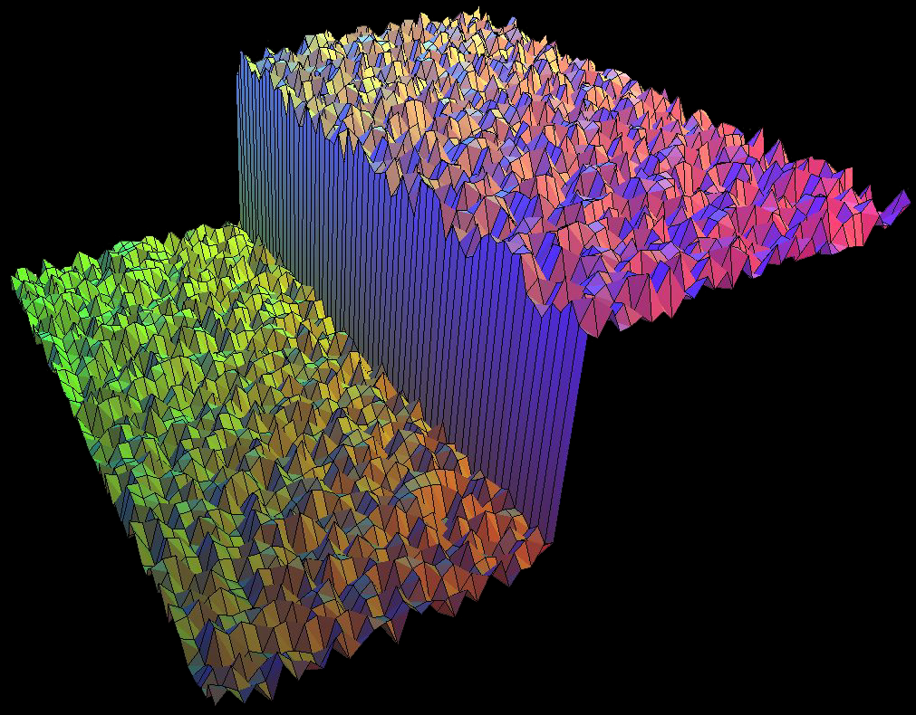

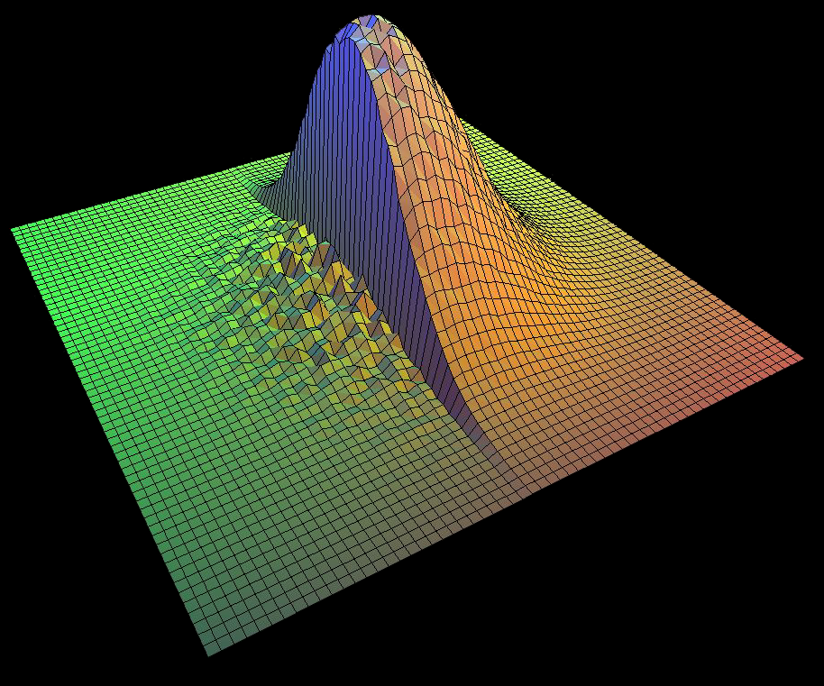

Bilateral Filter on a Height Field
output
input
reproduced
from [Durand 02]

Slide 8
Space and Range Parameters
space σ_{s} : spatial extent of the kernel, size of the considered neighborhood.
range σ_{r} : “minimum” amplitude of an edge

Slide 9
Influence of Pixels
Only pixels close in space and in range are considered.
space
range
p

Slide 10

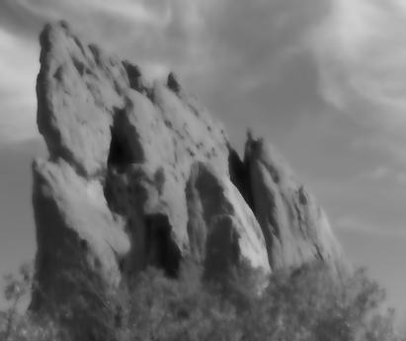




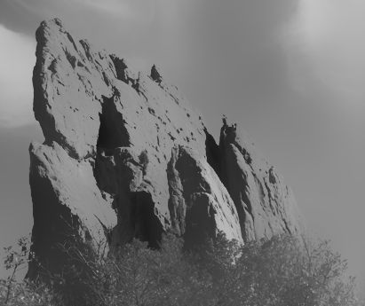
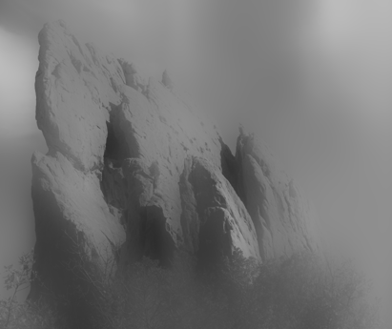

Exploring the Parameter Space
σ_{r} = ∞
(Gaussian blur)
σ_{r} = 0.1
σ_{r} = 0.25
input
σ_{s} = 2
σ_{s} = 6
σ_{s} = 18

Slide 11
Varying the Range Parameter
σ_{r} = ∞
(Gaussian blur)
σ_{r} = 0.1
σ_{r} = 0.25
input
σ_{s} = 2
σ_{s} = 6
σ_{s} = 18

Slide 12
input

Slide 13
σ_{r} = 0.1

Slide 14
σ_{r} = 0.25

Slide 15
σ_{r} = ∞
(Gaussian blur)

Slide 16
Varying the Space Parameter
σ_{r} = ∞
(Gaussian blur)
σ_{r} = 0.1
σ_{r} = 0.25
input
σ_{s} = 2
σ_{s} = 6
σ_{s} = 18

Slide 17
input

Slide 18
σ_{s} = 2

Slide 19
σ_{s} = 6

Slide 20
σ_{s} = 18

Slide 21
How to Set the Parameters
Depends on the application. For instance:
space parameter: proportional to image size
  e.g., 2% of image diagonal
range parameter: proportional to edge amplitude
  e.g., mean or median of image gradients
independent of resolution and exposure

Slide 22
A Few
More Advanced
Remarks

Slide 23


Bilateral Filter Crosses Thin Lines
Bilateral filter averages across
features thinner than ~2σ_{s}
Desirable for smoothing: more pixels = more robust
Different from diffusion that stops at thin lines
close-up
kernel

Slide 24
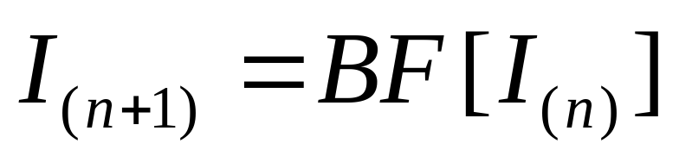
Iterating the Bilateral Filter
Generate more piecewise-flat images
Often not needed in computational photo.

Slide 25
input

Slide 26

1 iteration

Slide 27

2 iterations

Slide 28

4 iterations

Slide 29

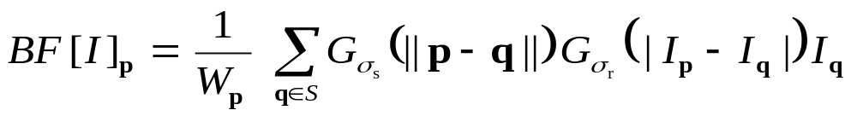
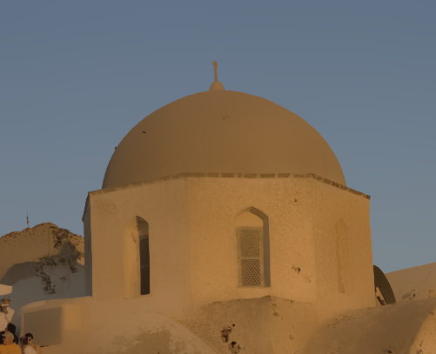
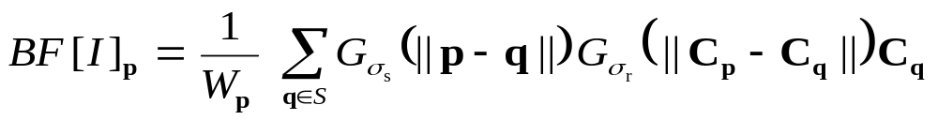
Bilateral Filtering Color Images
input
For gray-level images
intensity difference
scalar
output
For color images
color difference
3D vector
(RGB, Lab)
The bilateral filter is
extremely easy to adapt to your need.

Slide 30
Hard to Compute
Nonlinear
Complex, spatially varying kernels
  Cannot be precomputed, no FFT…
Brute-force implementation is slow > 10min

Slide 31
Questions ?

